Slide 1

MODERN TOPICS IN INFORMATION TECHNOLOGY
MTIT – 017
Information Technology Assignment
03 - Microservices

Slide 2
Student ID | Student Name
IT20241346 | Semini J.P.D.L.
IT20146238 | Jayathunga T.M.
IT20129712 | Godakanda P.G.S.
IT20254520 | Bhagya H.D.M.

Slide 3
What is Microservices ?
Microservices is an architectural style for developing software applications that emphasizes breaking down a large application into small, independent, and loosely coupled services that work together to form the complete application. Each service is designed to perform a specific function and communicates with other services through well-defined APIs.
In a microservices architecture, each service can be developed, deployed, and maintained independently of the others, allowing for greater agility and scalability. This approach also allows for the use of different programming languages, frameworks, and technologies within each service, if they can communicate with each other through their APIs.
Overall, microservices architecture is often favored for its ability to increase flexibility, improve fault tolerance, and accelerate development cycles. However, it also adds complexity and requires careful planning and management to ensure effective coordination between services.

Slide 4
Domain -Sports Items Store
A Sports Items Store could use a microservices architecture to break down its application into smaller, more manageable services that work together to form a complete system. The platform can consist of microservices that handle various parts of the sports item store, such as Store Services, Manager Services ,Supply Management, Transport Management

Slide 5
Need of the API Gateway for Microservices
Routing: An API Gateway can act as a router for incoming requests, directing them to the appropriate microservice based on the endpoint or URL. This allows clients to access different microservices through a single endpoint, simplifying the overall architecture.
Load Balancing: An API Gateway can also distribute incoming requests to multiple instances of a microservice, helping to balance the load and improve performance.
Service Discovery: An API Gateway can use service discovery mechanisms to locate the appropriate microservice instance to handle a given request. This helps to ensure that requests are always directed to a healthy and available instance of the microservice.
Security: An API Gateway can handle security concerns such as authentication and authorization. It can authenticate the client making the request and authorize access to the requested microservice. This helps to ensure that only authorized clients can access the microservices and protects against unauthorized access.
Protocol Translation: An API Gateway can handle protocol translation, converting requests from one protocol to another. For example, it can translate a request from HTTP to gRPC or WebSocket. This allows clients to use different protocols to access the microservices without requiring the microservices themselves to support multiple protocols.

Slide 6
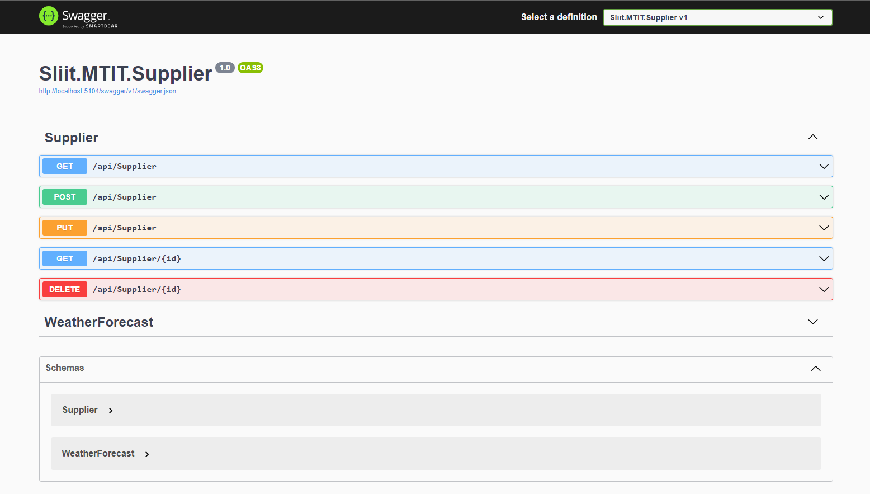
IT20146238 – Jayathunga T.M. – Supplier Microservice

Slide 7
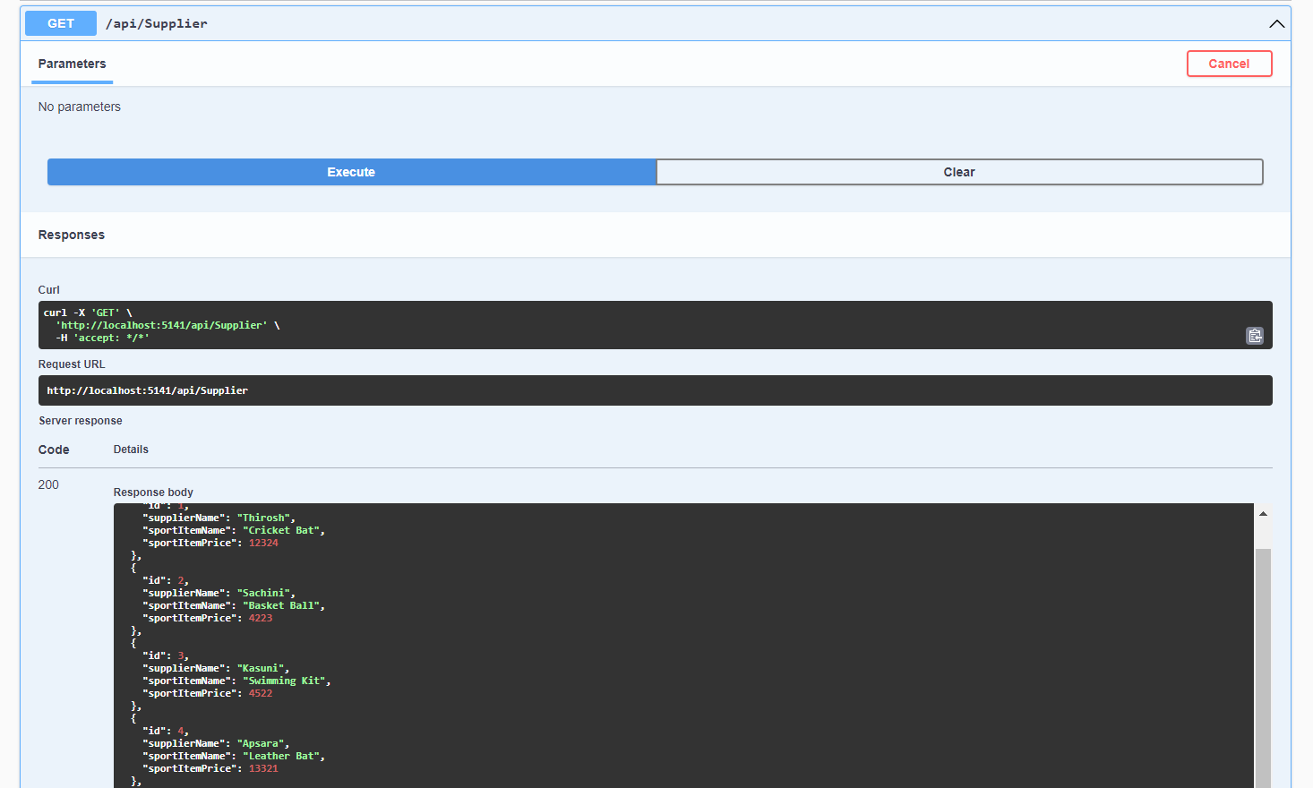
Supplier GET Method

Slide 8
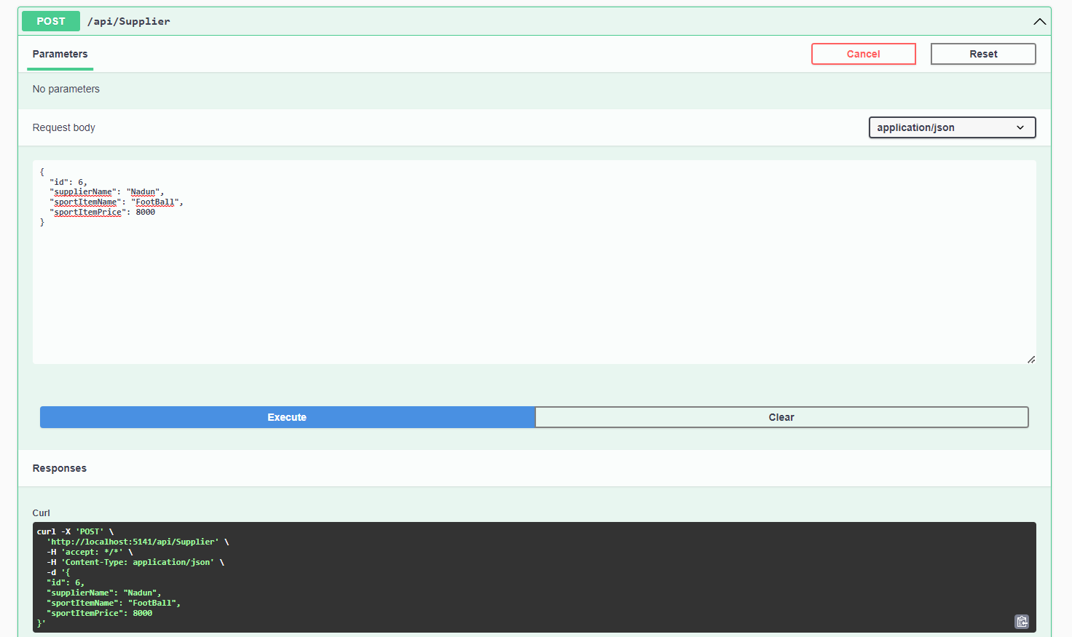
Supplier POST Method

Slide 9
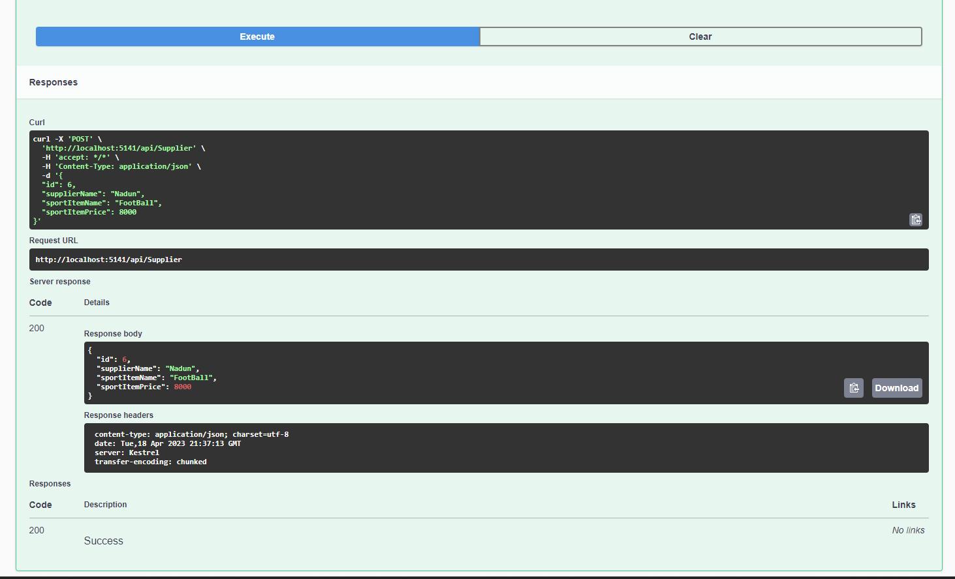

Slide 10
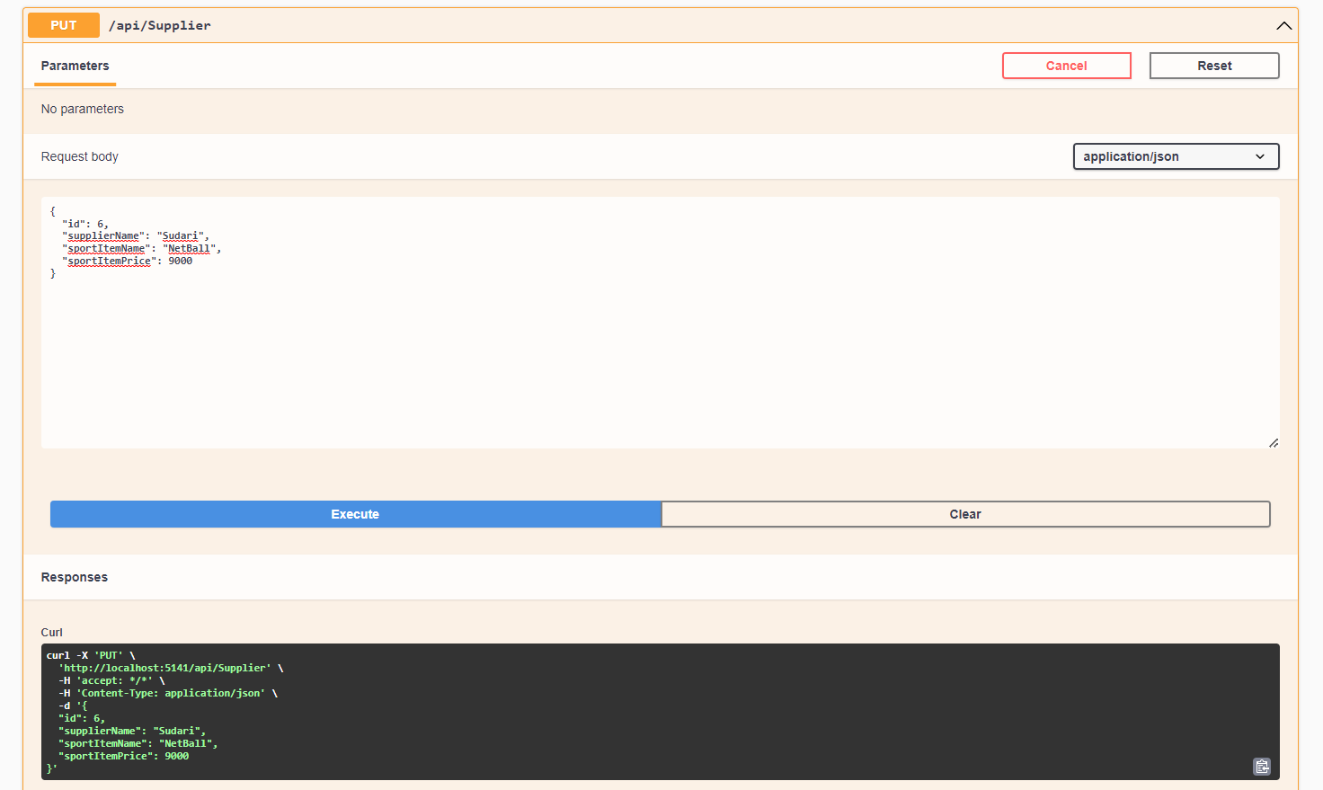
Supplier PUT Method

Slide 11
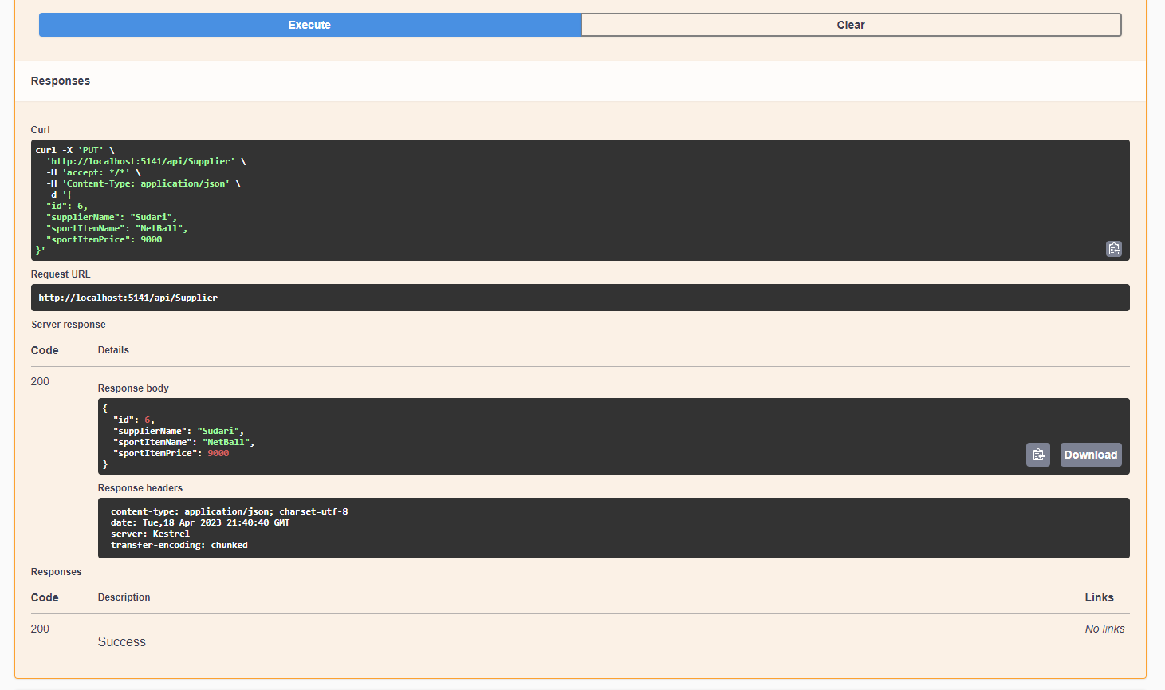

Slide 12
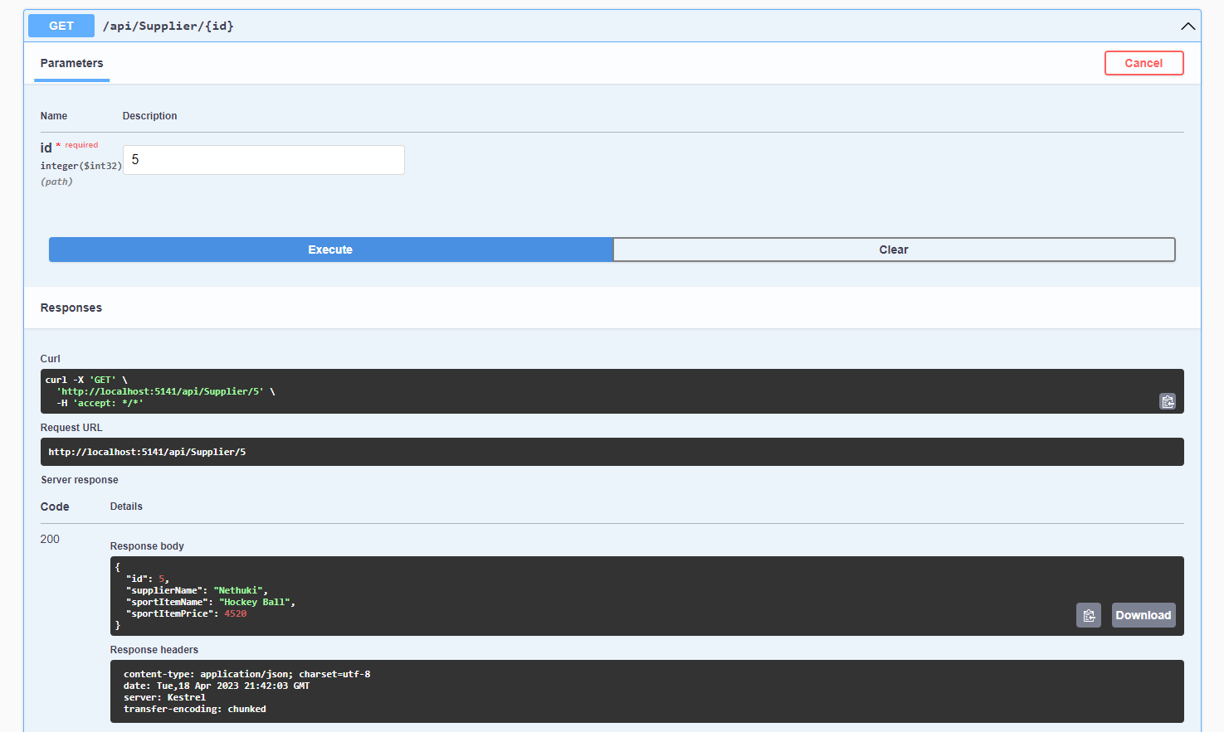
Supplier Search ID GET Method

Slide 13
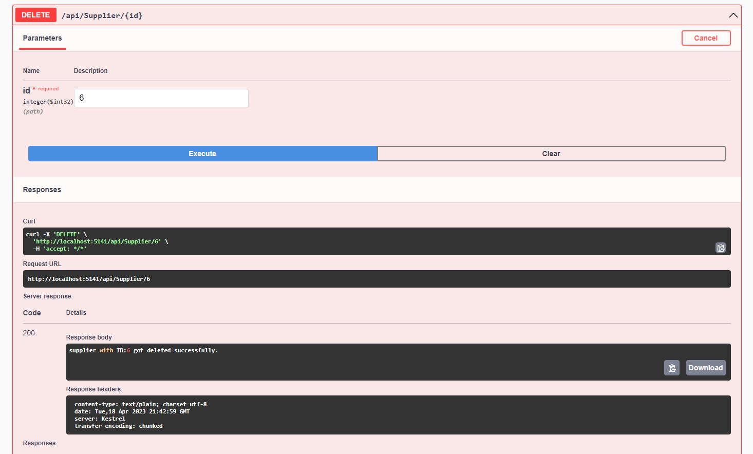
Supplier DELETE Method

Slide 14
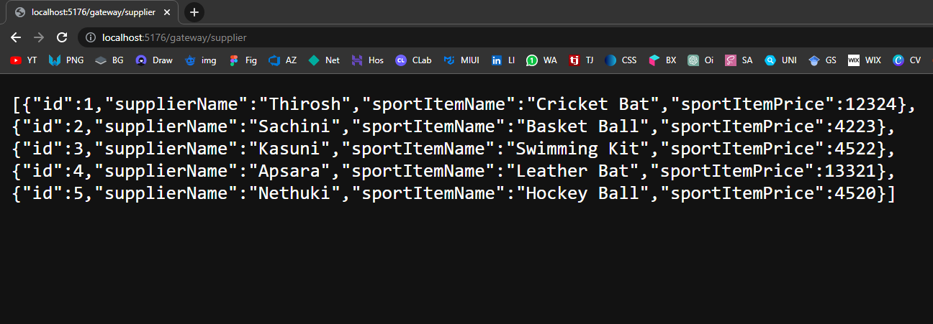
Supplier Up Stream URL in Browser

Slide 15
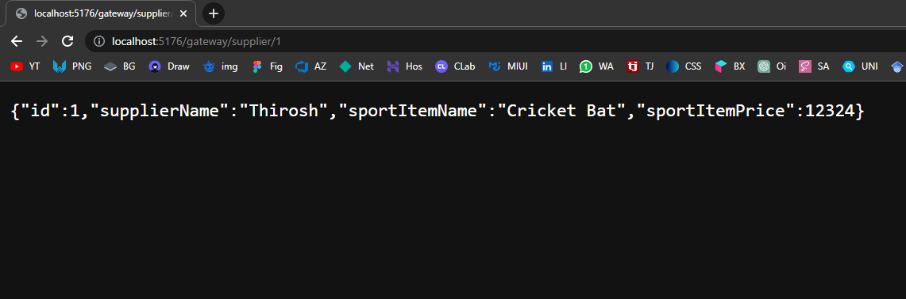
Supplier Up Stream URL in Browser

Slide 16
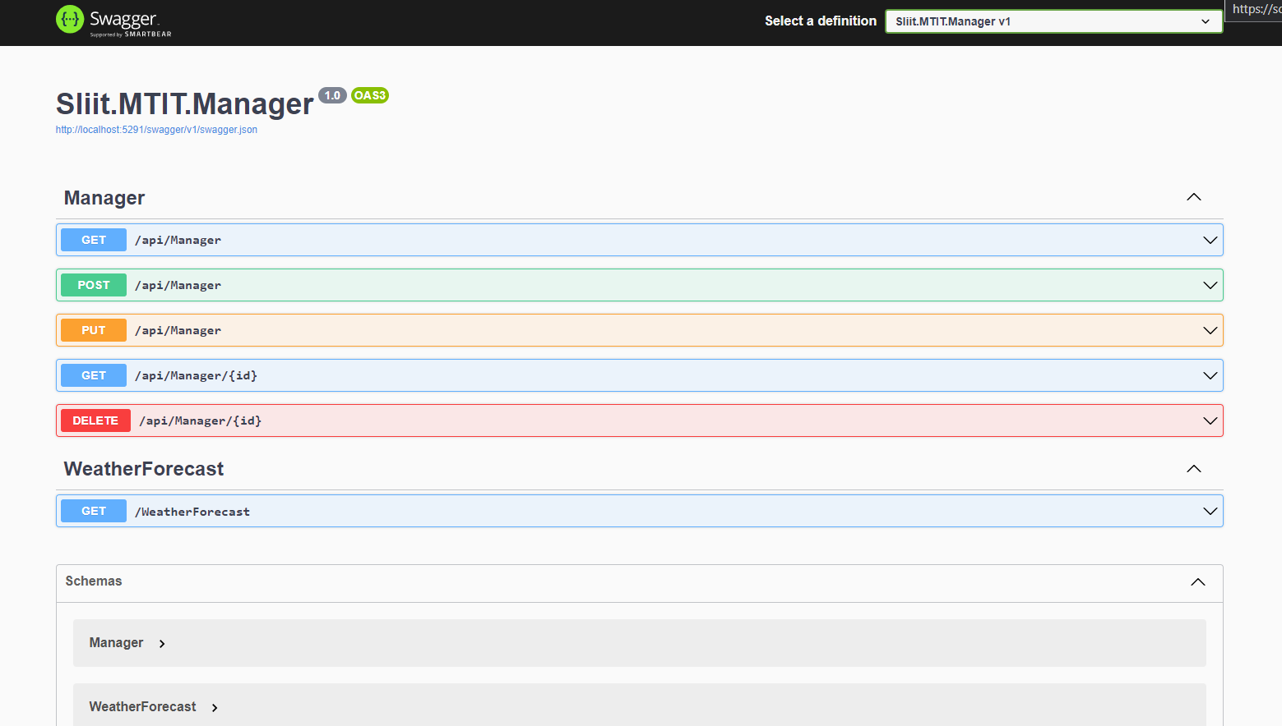
IT20241346 – Semini J.P.D.L.– Manager Microservice

Slide 17
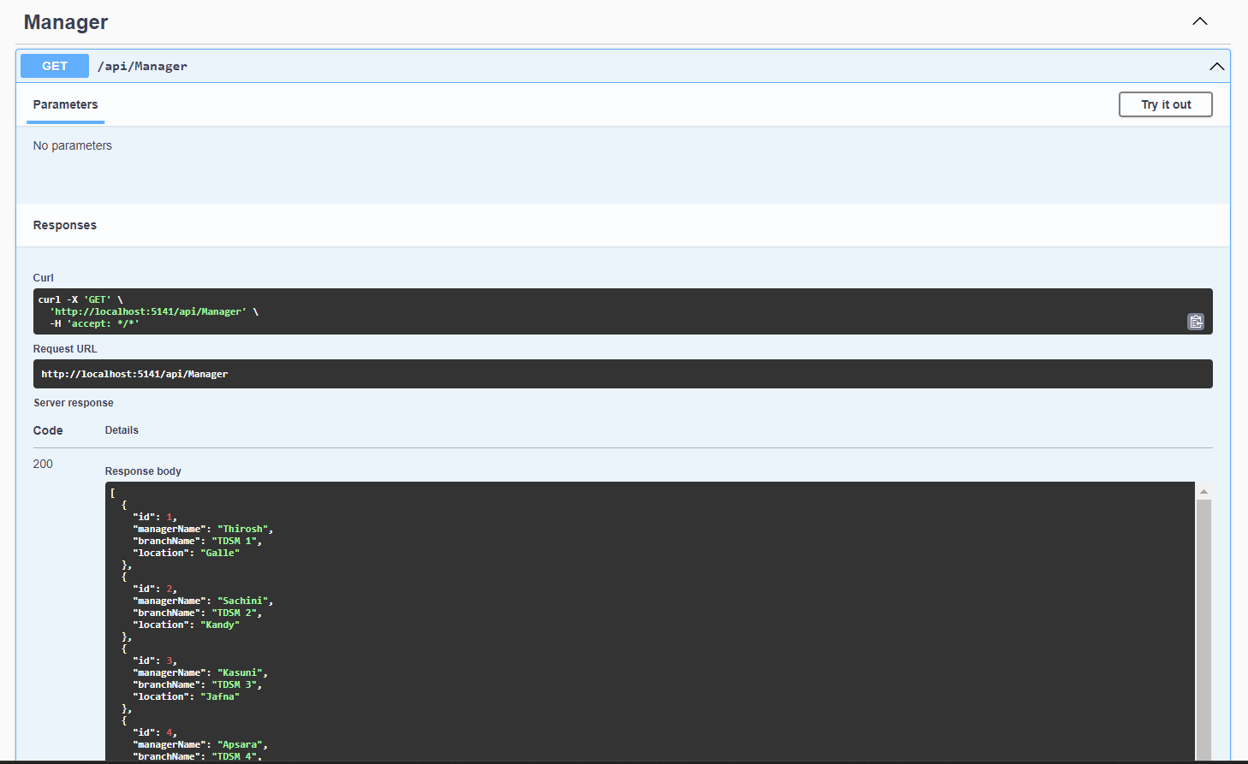
Manager GET Method

Slide 18

Manager POST Method

Slide 19
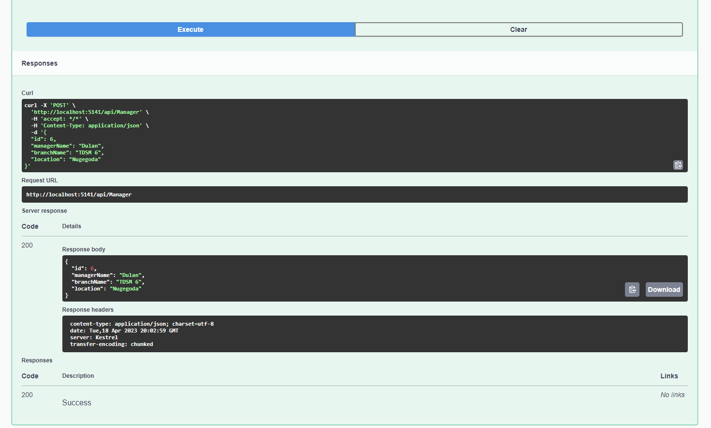

Slide 20
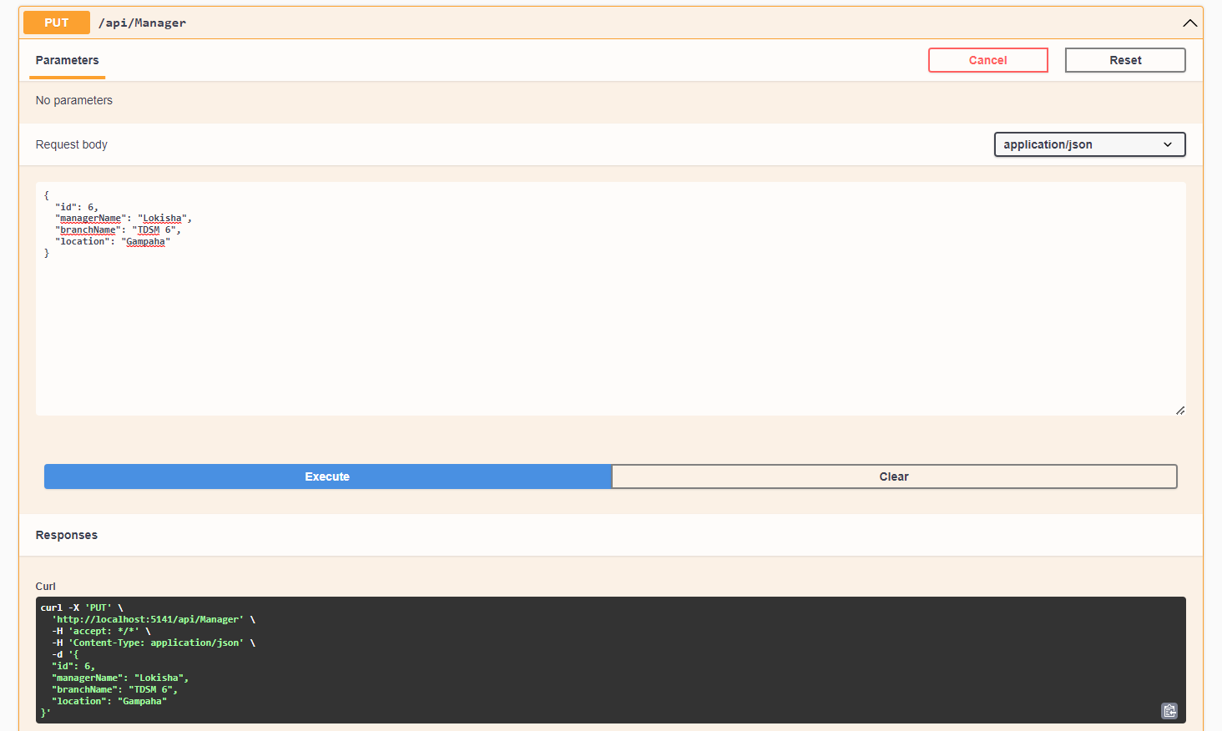
Manager PUT Method

Slide 21
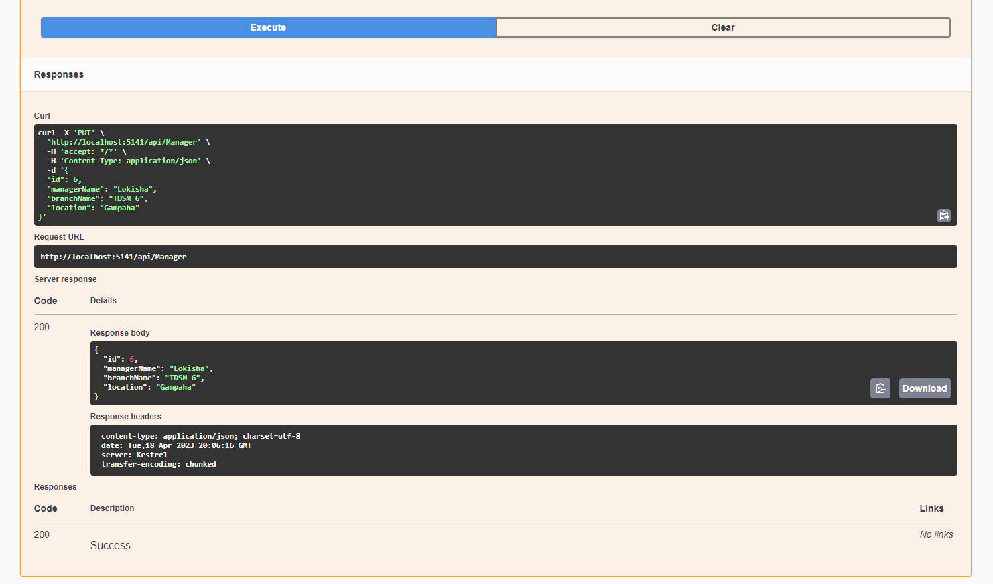

Slide 22
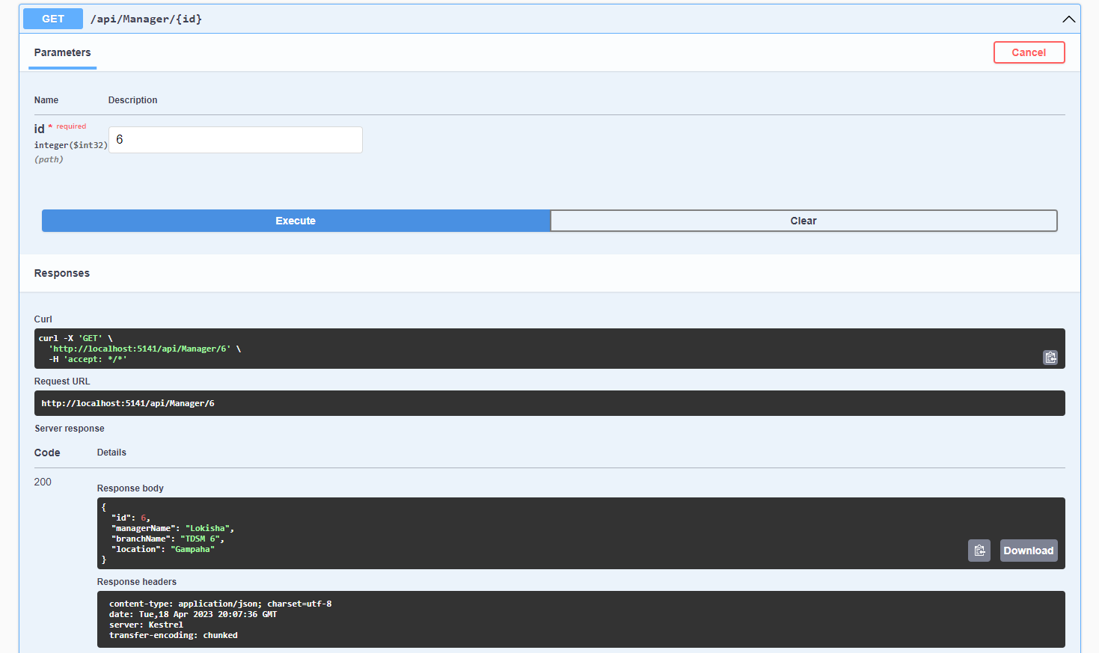
Manager Search ID GET Method

Slide 23
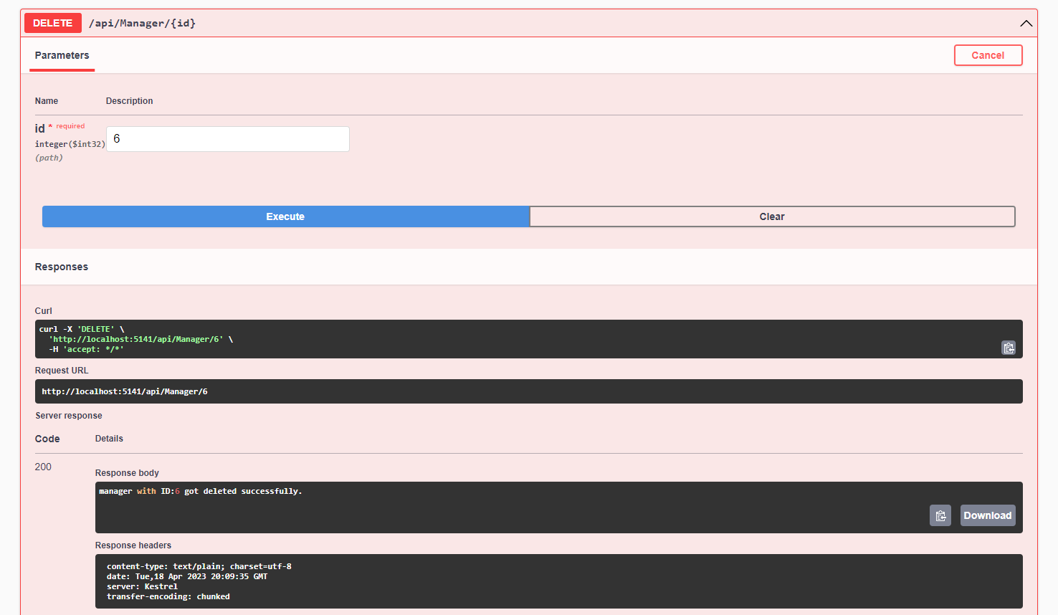
Manager DELETE Method

Slide 24
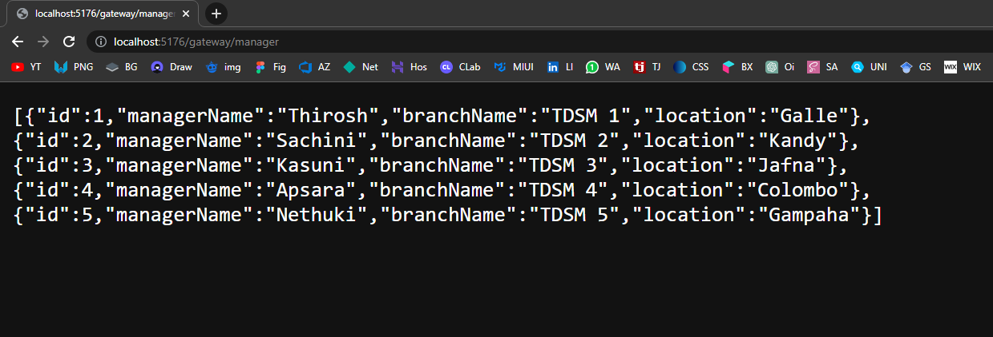
Manager Up Stream URL in Browser

Slide 25
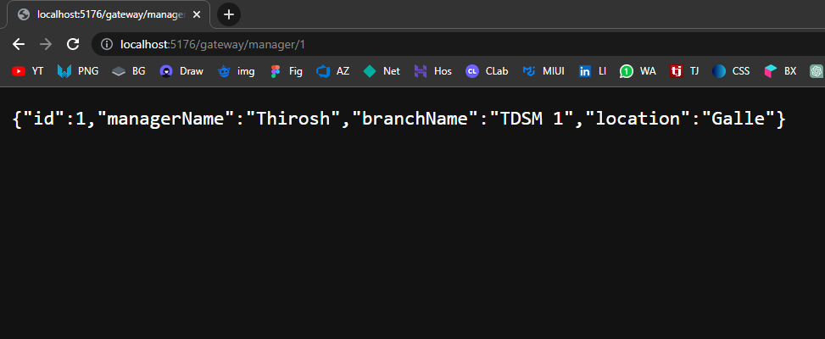
Manager Up Stream URL in Browser

Slide 26
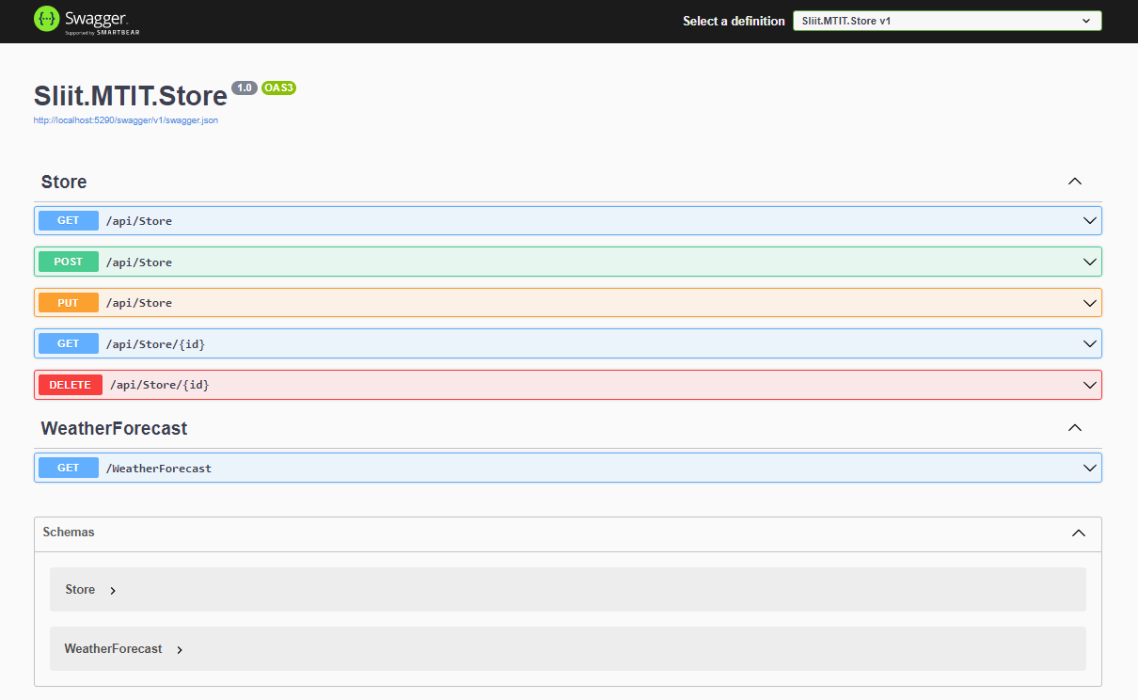
IT20254520 – Bhagya H.D.M. - Store Microservice

Slide 27
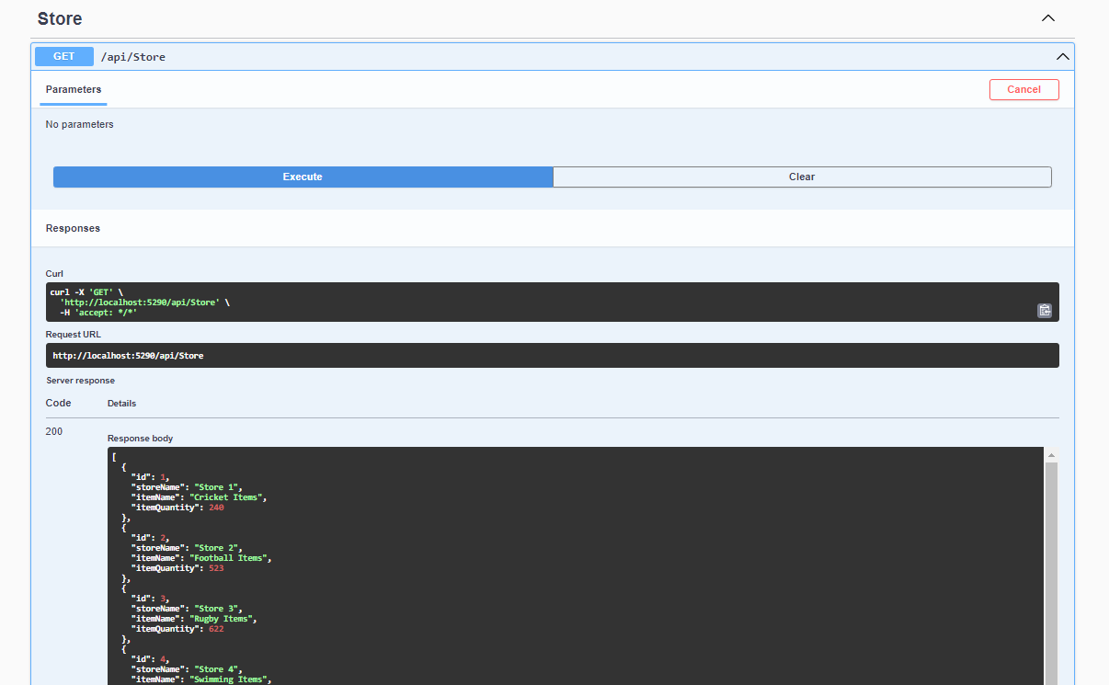
Store GET Method

Slide 28
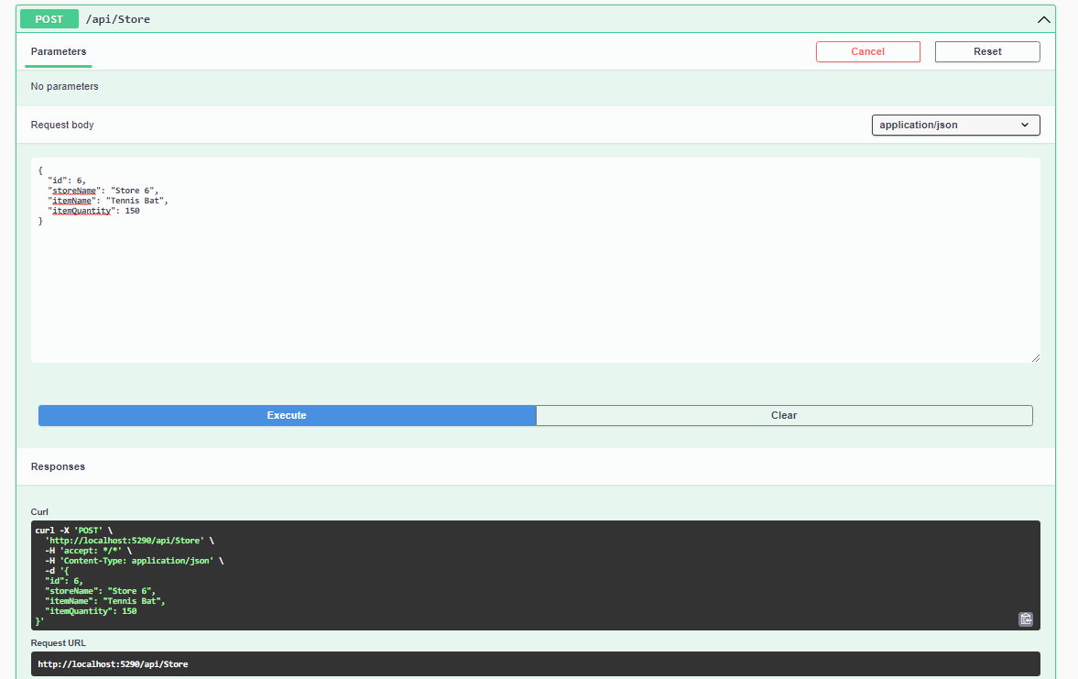
Store POST Method

Slide 29
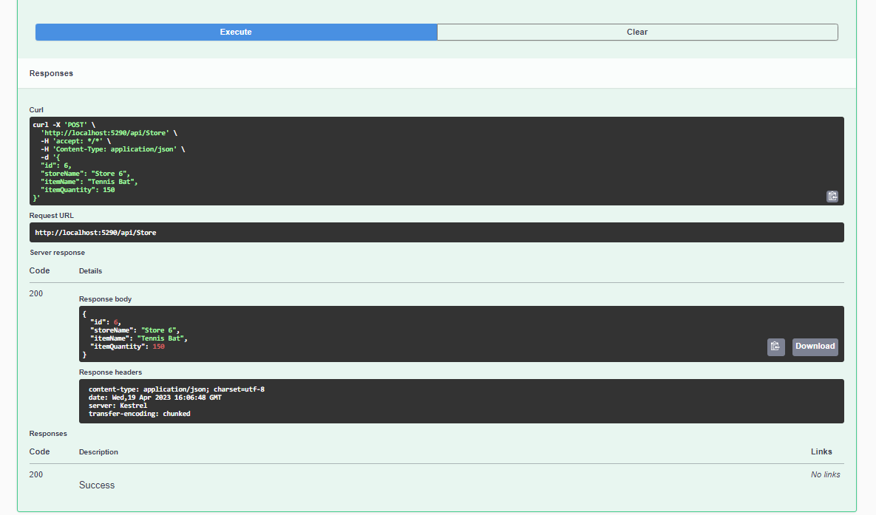

Slide 30
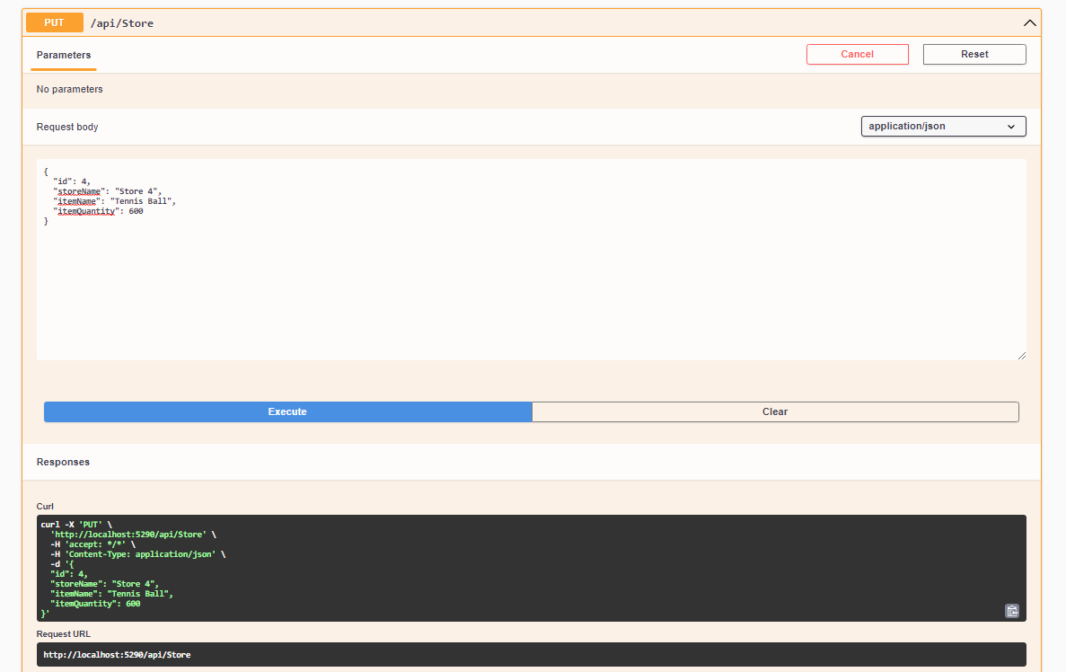
Store PUT Method

Slide 31
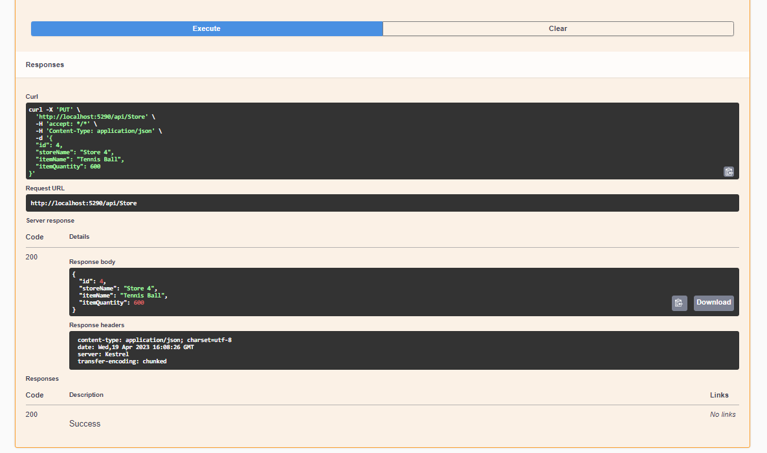

Slide 32
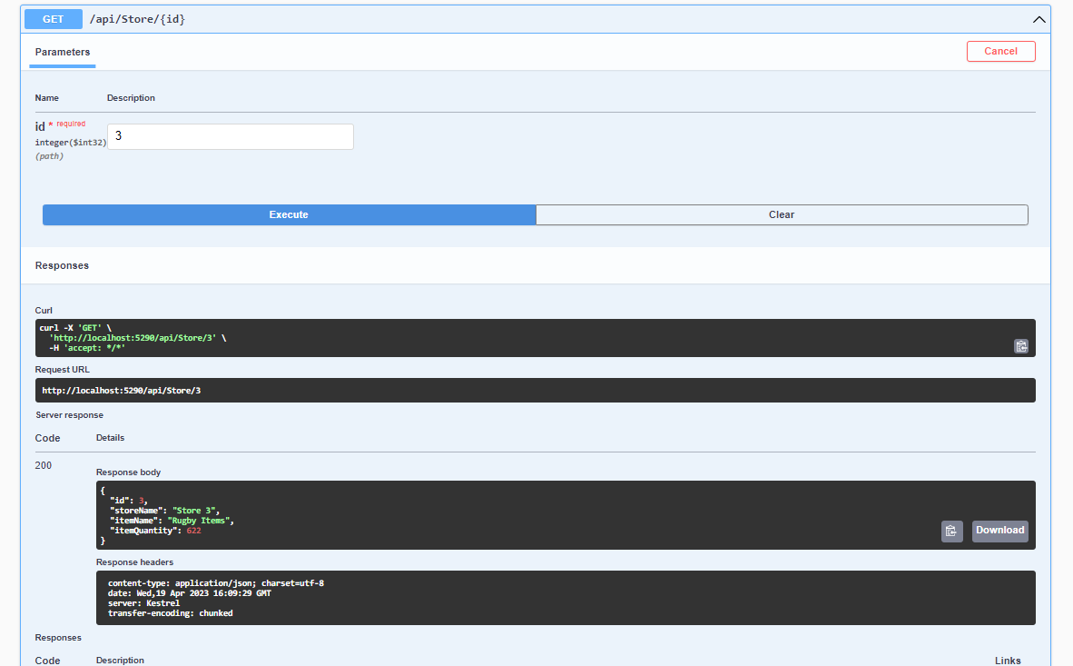
Store Search ID GET Method

Slide 33
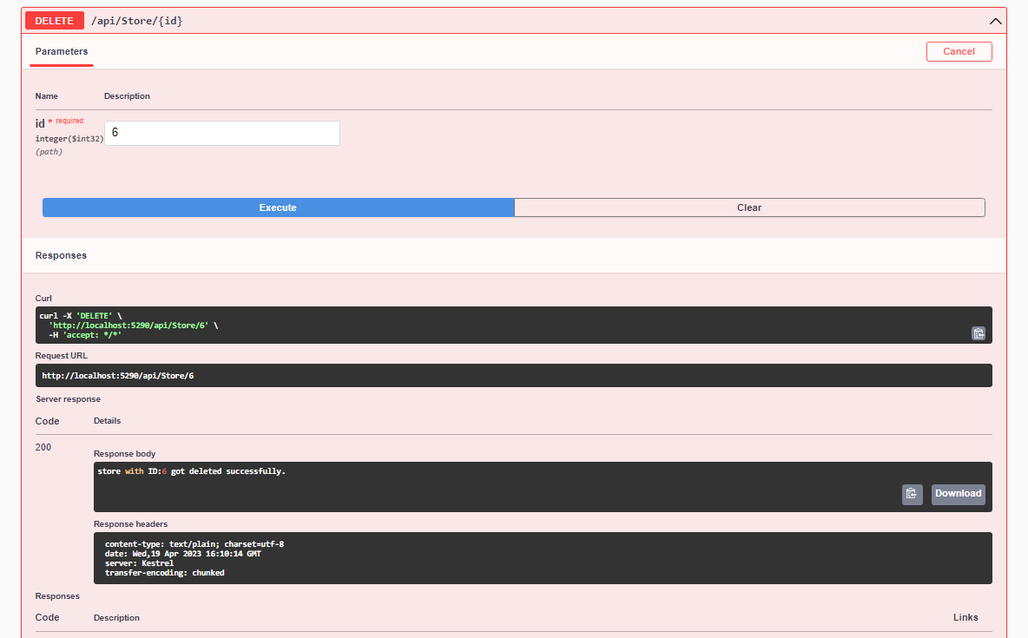
Store DELETE Method

Slide 34
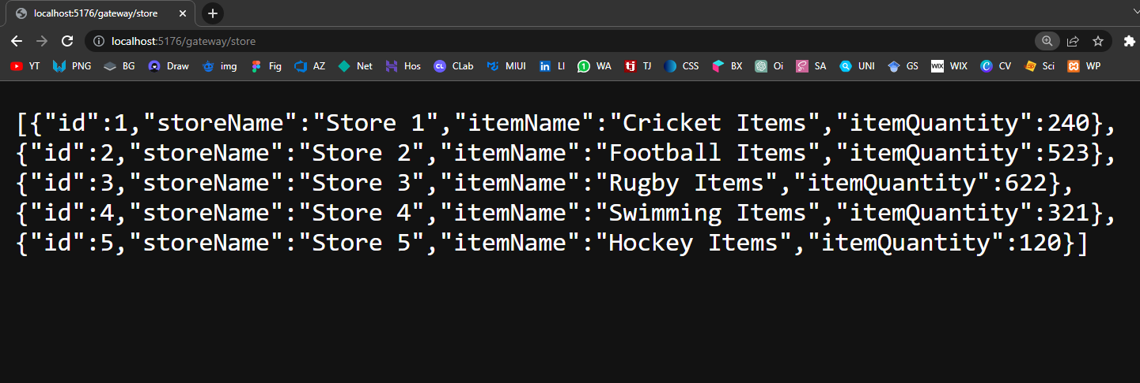
Store Up Stream URL in Browser

Slide 35
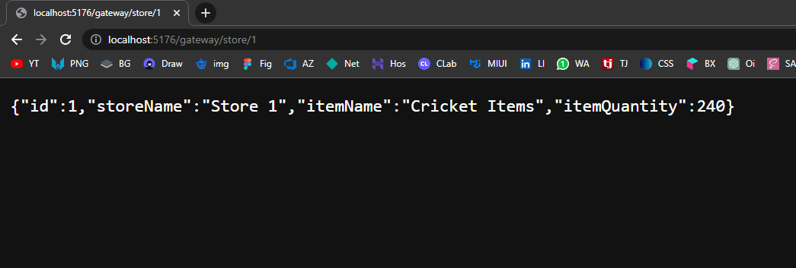
Store Up Stream URL in Browser

Slide 36
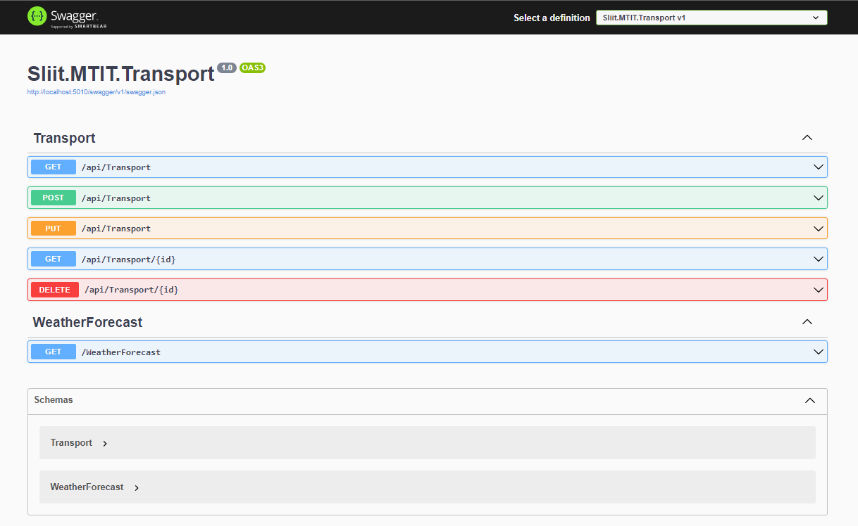
IT20129712 – Godakanda P.G.S. -Transport Microservice

Slide 37
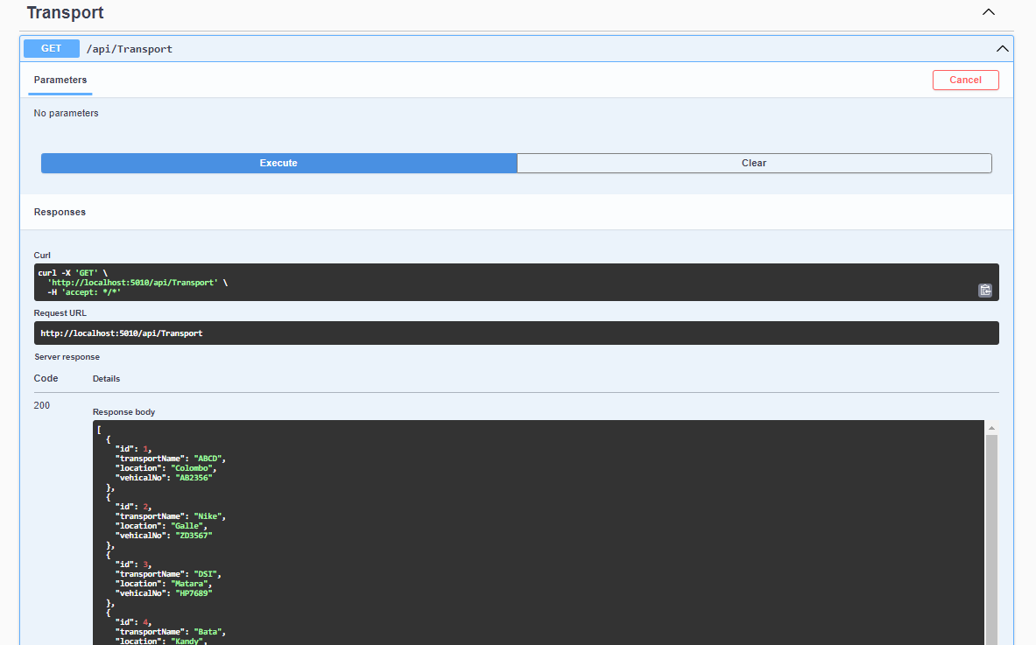
Transport GET Method

Slide 38
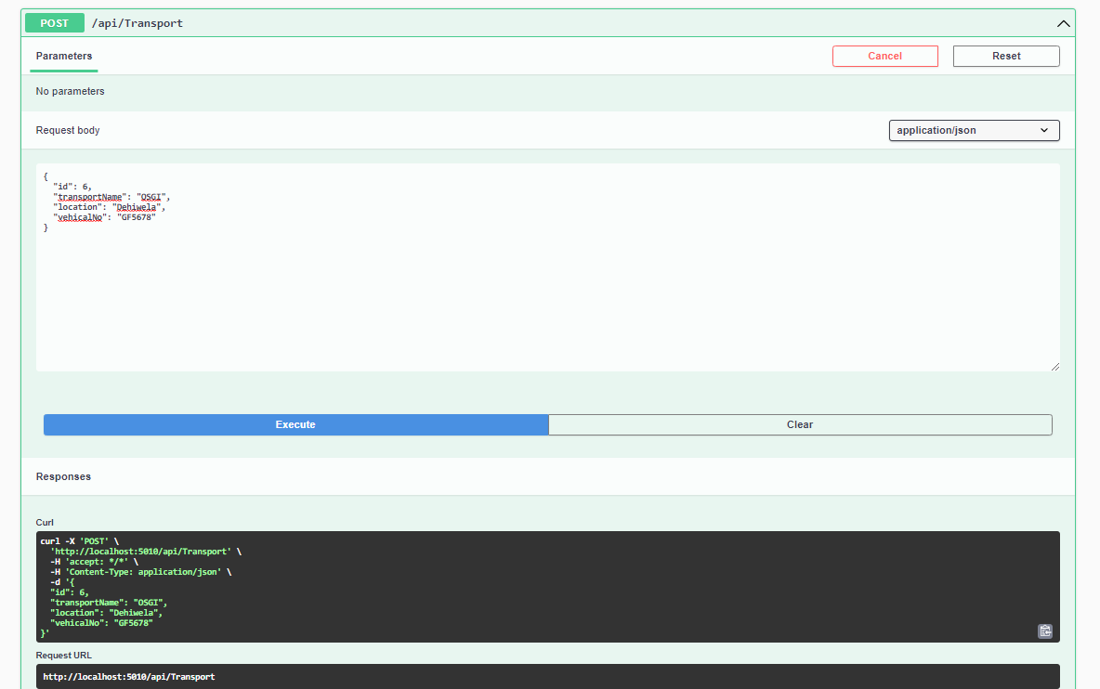
Transport POST Method

Slide 39
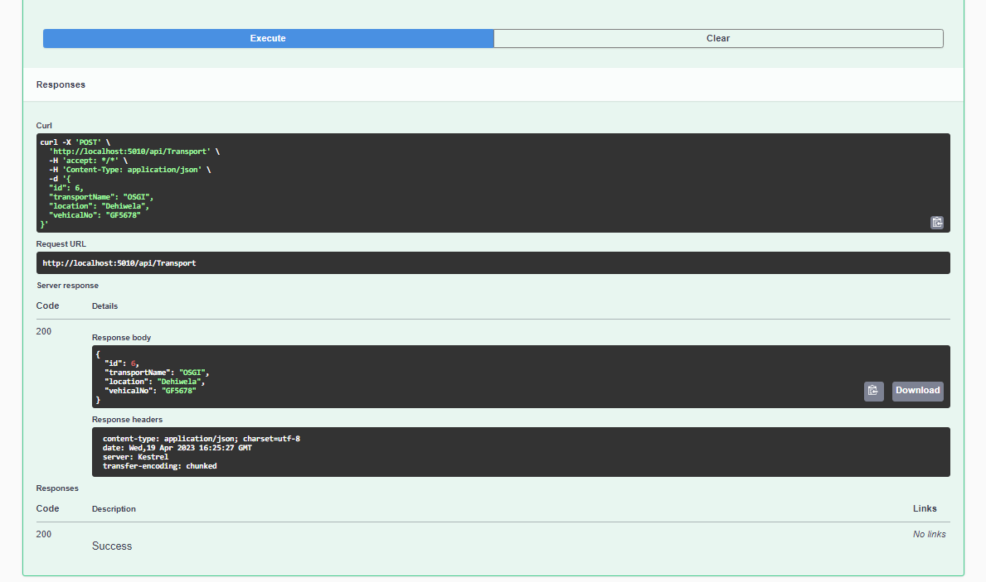

Slide 40
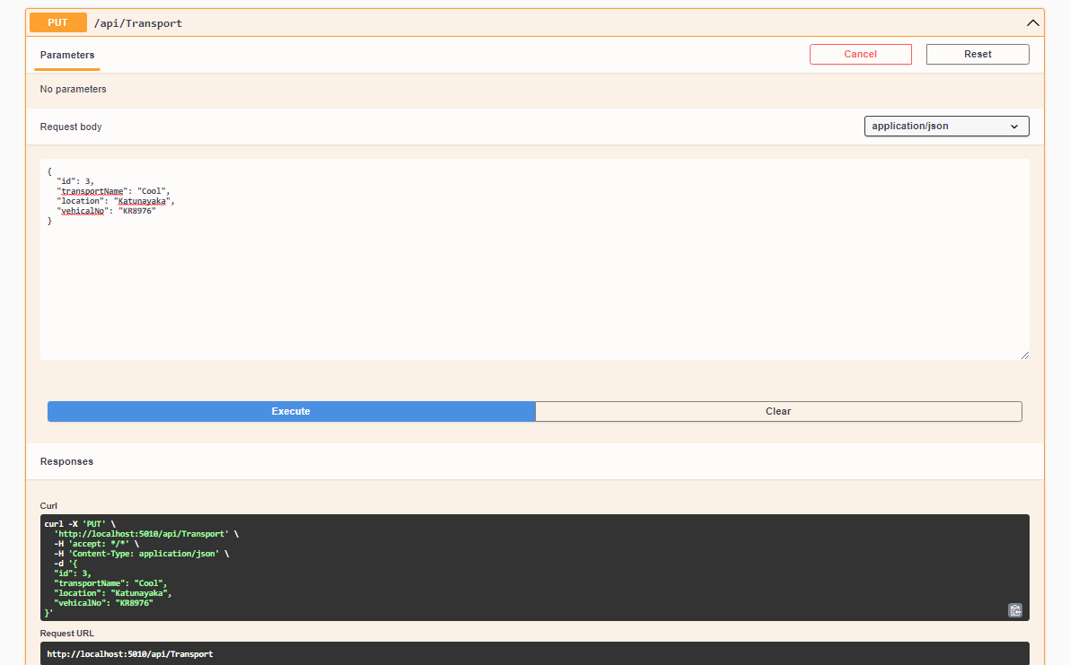
Transport PUT Method

Slide 41
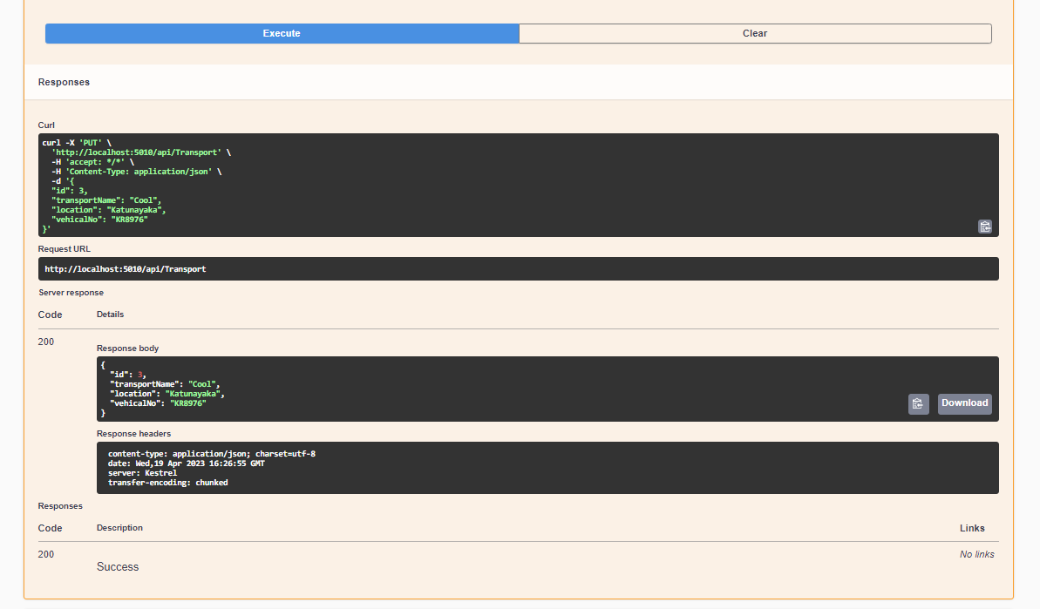

Slide 42
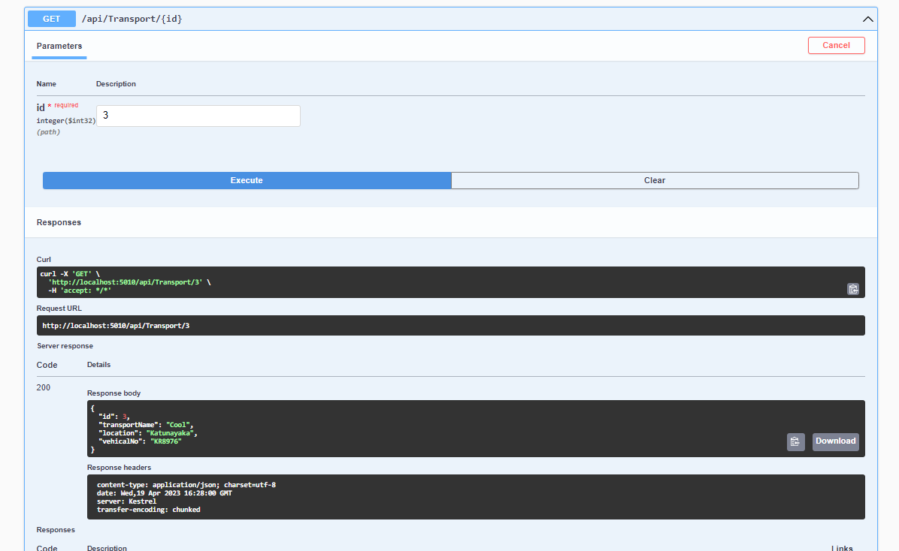
Transport Search ID GET Method

Slide 43
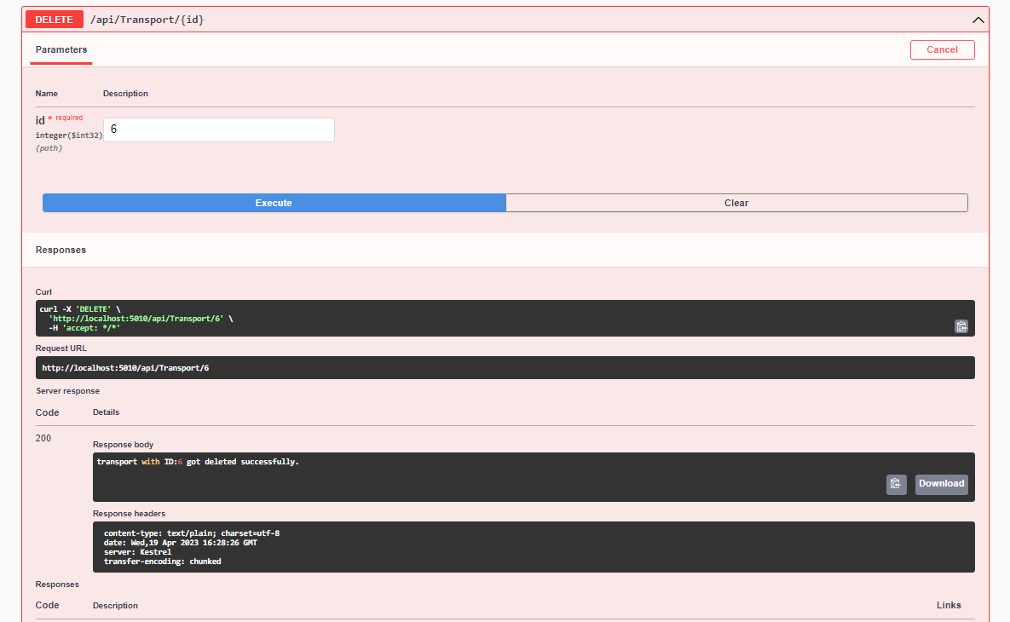
Transport DELETE Method

Slide 44
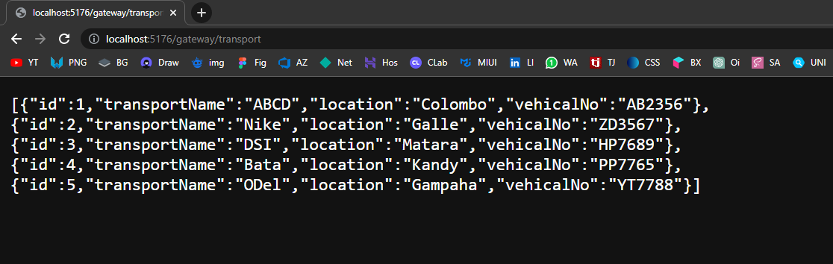
Transport Up Stream URL in Browser

Slide 45
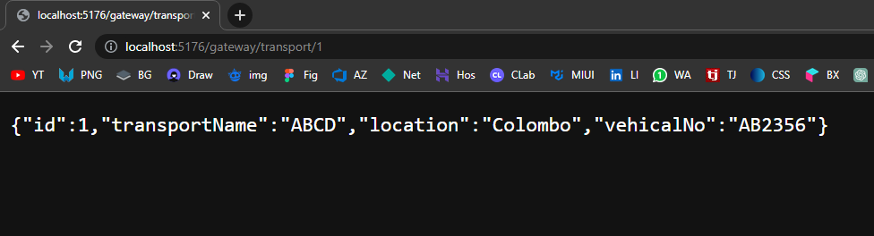
Transport Up Stream URL in Browser

Slide 46
Source Code Link
Link: https://github.com/ThiroshMadhusha/Microservices-Ocelote

